Slide 1
Sorting algorithms
Selection sort, Bubble sort, Insertion sort, Shell sort, Merge sort, Heap sort, Quick sort
Data Structures, Fall 2018
TA: Marija Stanojevic

Slide 2
Selection sort
Simplest sorting algorithm, requires O(n²) time always
Algorithm: Find minimum in unsorted part of the array and puts it to the beginning of the unsorted part; then, considers that element as sorted and starts sorting from the next element
void sort(int arr[]) {
int n = arr.length;
for (int i = 0; i < n-1; i++) {
int min_idx = i; // Find the minimum element in unsorted part of array
for (int j = i+1; j < n; j++)
if (arr[j] < arr[min_idx])
min_idx = j; // Swap the found minimum element with the first element of unsorted part
int temp = arr[min_idx];
arr[min_idx] = arr[i];
arr[i] = temp;
}
} //time complexity: best: O(n²), average: O(n²), worst: O(n²)

Slide 3
Bubble sort
Idea: easy bubbles go up in the water
Algorithm: Compare every two consecutive numbers. If they are in wrong order, swap them. Move by 1. If at least one swap happen in the last pass, start new pass through the list
Algorithm needs one whole pass without any swap to know it is sorted
First pass:
( 5 1 4 2 8 ) –> ( 1 5 4 2 8 ), swap since 5 > 1
( 1 5 4 2 8 ) –> ( 1 4 5 2 8 ), swap since 5 > 4
( 1 4 5 2 8 ) –> ( 1 4 2 5 8 ), swap since 5 > 2
( 1 4 2 5 8 ) –> ( 1 4 2 5 8 ), don’t swap 5 < 8
Second Pass:
( 1 4 2 5 8 ) –> ( 1 4 2 5 8 )
( 1 4 2 5 8 ) –> ( 1 2 4 5 8 ), Swap since 4 > 2
( 1 2 4 5 8 ) –> ( 1 2 4 5 8 )
( 1 2 4 5 8 ) –> ( 1 2 4 5 8 )
Third Pass:
( 1 2 4 5 8 ) –> ( 1 2 4 5 8 )
( 1 2 4 5 8 ) –> ( 1 2 4 5 8 )
( 1 2 4 5 8 ) –> ( 1 2 4 5 8 )
( 1 2 4 5 8 ) –> ( 1 2 4 5 8 )
void sort(int arr[]) {
int n = arr.length;
for (int i = 0; i < n-1; i++)
for (int j = 0; j < n-i-1; j++)
if (arr[j] > arr[j+1]) {
// swap temp and arr[i]
int temp = arr[j];
arr[j] = arr[j+1];
arr[j+1] = temp;
} //time complexity: best: O(n),
} // average: O(n²), worst: O(n²)

Slide 4
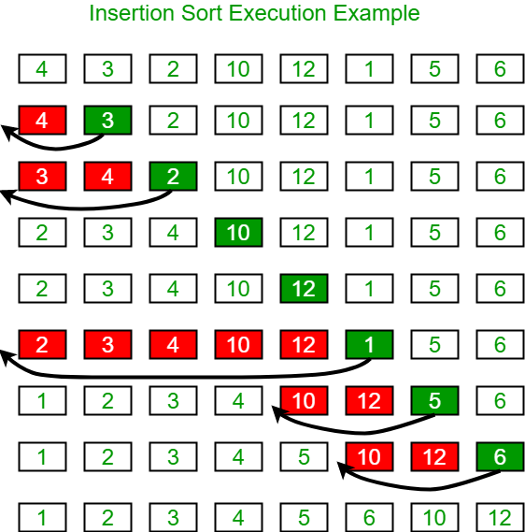
Insertion sort
Algorithm: starting from second element compare each element with its predecessors until smaller value is found. Put current element after that value. Go to the next element.
void sort(int arr[]) {
int n = arr.length;
for (int i=1; i<n; ++i) {
int key = arr[i];
int j = i-1;
while (j>=0 && arr[j] > key) {
arr[j+1] = arr[j];
j = j-1;
}
arr[j+1] = key;
} //time complexity: best: O(n),
} // average: O(n²), worst: O(n²)

Slide 5
Shell sort
Idea: sorting books on the shell
Algorithm: Compare pairs of elements separated by X elements (gap). If they are not in good order, swap them. Divide X by 2 and repeat the process until X = 0.
void sort(int arr[]) {
int n = arr.length;
for (int gap = n/2; gap > 0; gap /= 2)
for (int i = gap; i < n; i += 1) {
int temp = arr[i];
int j;
for (j = i; j >= gap && arr[j - gap] > temp; j -= gap)
arr[j] = arr[j - gap];
arr[j] = temp;
}
} //time complexity: best: O(n log n), worst: O(n^{4/3})

Slide 6
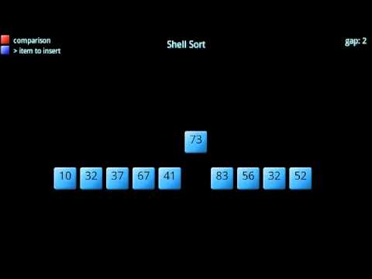

Slide 7
Merge sort
Highly parallelizable => divide on n machines => time complexity O(log n)
Algorithm: Divide array into halfs recursively and once we array has only two order those. Then return back into bigger case and merge those sorted arrays.
Space complexity: O(n);
void mergeSort(int[] a, int n) {
if (n < 2) return;
int mid = n / 2;
int[] l = new int[mid];
int[] r = new int[n - mid];
for (int i = 0; i < mid; i++) {
l[i] = a[i];
}
for (int i = mid; i < n; i++) {
r[i - mid] = a[i];
}
mergeSort(l, mid);
mergeSort(r, n - mid);
merge(a, l, r, mid, n - mid);
} // Time complexity: best: O(n log n), average: O(n log n), worst: O(n log n)
void merge(int[] a, int[] l, int[] r, int left, int right) {
int i = 0, j = 0, k = 0;
while (i<left && j < right) {
if (l[i] < r[j]) {
a[k++] = l[i++];
} else {
a[k++] = r[j++];
}
}
while (i < left) {
a[k++] = l[i++];
}
while (j < right) {
a[k++] = r[j++];
}
}

Slide 8


Slide 9
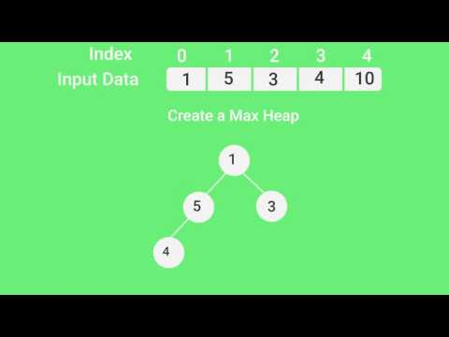
Heap sort
void sort(int arr[]) {
int n = arr.length;
for (int i=n/2-1; i >= 0; i--)
heap(arr, n, i);
for (int i=n-1; i>=0; i--) {
int temp = arr[0];
arr[0] = arr[i];
arr[i] = temp;
heap(arr, i, 0);
}
}
void heap(int arr[],int n,int i) {
int largest = i;
int l = 2*i + 1;
int r = 2*i + 2;
if (l<n && arr[l]>arr[largest])
largest = l;
if (r<n && arr[r]>arr[largest])
largest = r;
if (largest != i) {
int swap = arr[i];
arr[i] = arr[largest];
arr[largest] = swap;
heapify(arr, n, largest);
} // Time: best: O(n log n), avg: } // O(n log n), worst: O(n log n)

Slide 10
Quick sort
Similar to MergeSort; both are used in Java for sorting
Algorithm: Picks an element as pivot and partitions around it. Partitioning exchange elements so that elements smaller than pivot go to the left and elements bigger than pivot go to the right. Then, sort is called for each of those two parts recursively.
int part(int arr[],int low,int high) {
int pivot = arr[high];
int i = (low-1);
for (int j=low; j<high; j++) {
if (arr[j] <= pivot) {
i++;
int temp = arr[i];
arr[i] = arr[j];
arr[j] = temp;
}
}
int temp = arr[i+1];
arr[i+1] = arr[high];
arr[high] = temp;
return i+1;
}
Pivot can be chosen in different ways:
Pick first / last element
Pick a random element
Pick median
void sort(int arr[], int low, int high) {
if (low < high) {
int pi = part(arr, low, high);
sort(arr, low, pi-1);
sort(arr, pi+1, high);
} // Time complexity: best: O(n),
} // average: O(n log n), worst: O(n²)

Slide 11


